Slide 1
ZOMATO REVIEW SYSTEM
THE ANALYSTS:
NAMAN.V
KALYAN.J
KEERTHAN.K
HASWANTH.V
Guides:
Deepika and Nidhi ma’am,
Prashanth Sir

Slide 2
ABOUT THE PROJECT
This project is based on Zomato review system.
Our aim is to analyse the reviews given by customers on different restaurants and give a consolidated review on the specific restaurant which would help the user to judge and pick restaurant of his choice based on the rating.
The outcome of this review analysis would show the user if the restaurant is either recommended or not recommended based on previous reviews.

Slide 3
TECHNICAL DESCRIPTION
We have used data pre-processing and NLP( Natural Language Processing) to achieve the outcome.
We have used NLTK (Natural Language Toolkit) and VaderSentiment package to understand the reviews given by the users.
VaderSentiment is a package which generates a score(vaderReviewScore) depending on the intensity of the review/comment which helps in precise understanding of the review and makes it easy for classification or segregation.

Slide 4
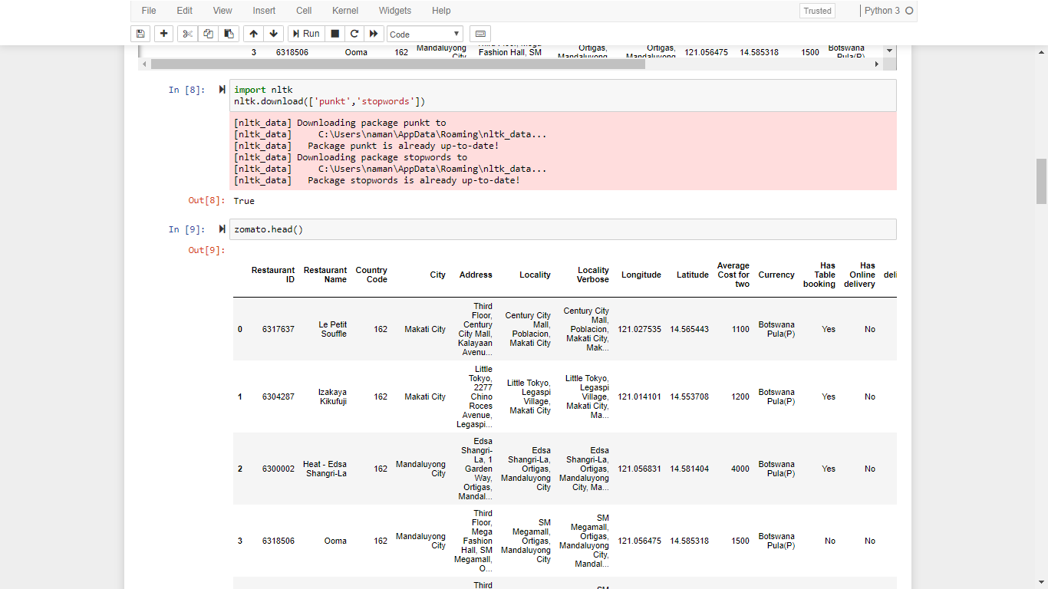
CODE SNIPPETS

Slide 5
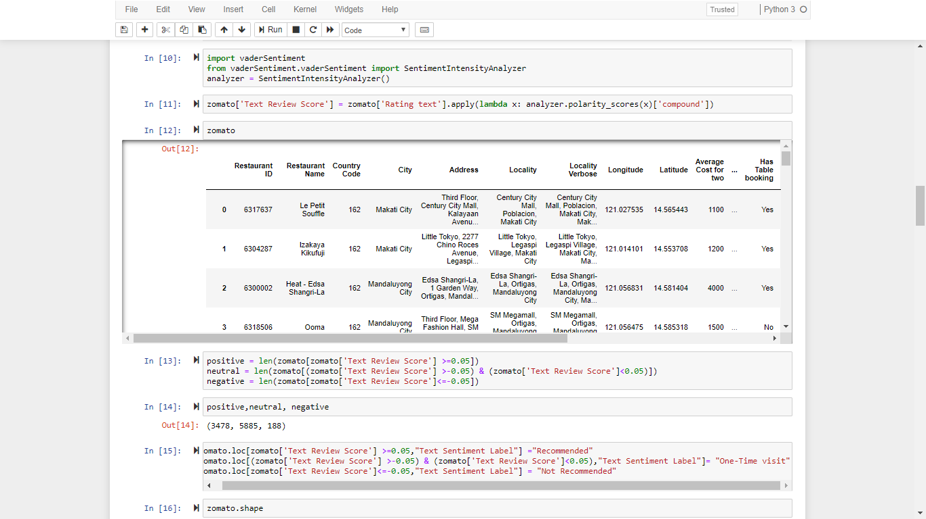

Slide 6
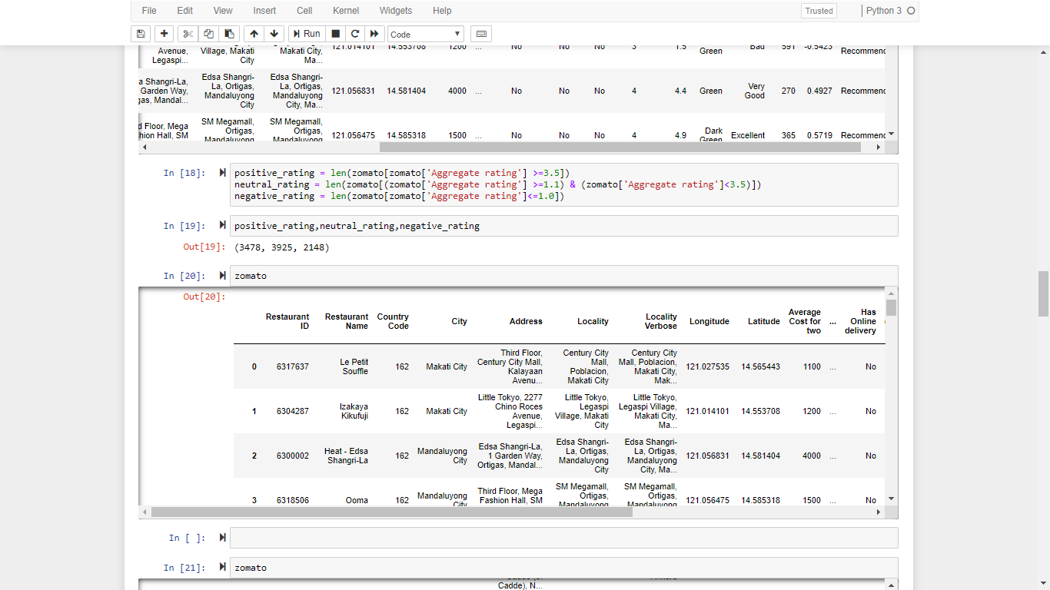

Slide 7
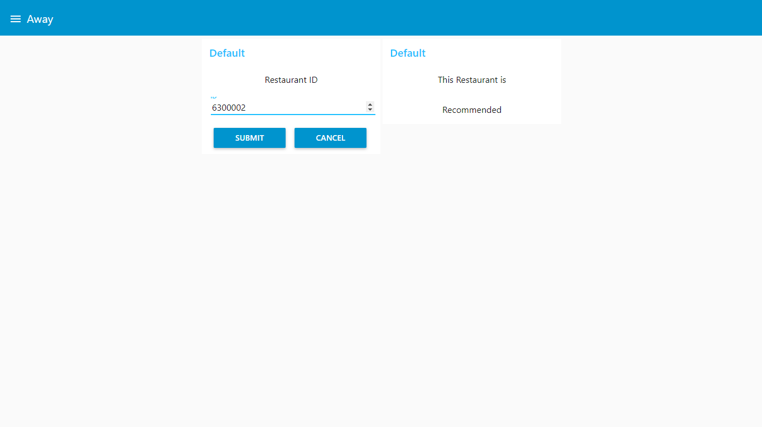
USER INTERFACE IMPLEMENTATION

Slide 8
CONCLUSION & FUTURE SCOPE
We would be giving the user a calculated and aggregate rating and review on the chosen restaurant.
This project could be further be developed into a recommendation system for the general public after improvising on it by adding more features and filters.
After improvising this project model and methodology could be used and implemented on a wider scale.

Slide 9
WE WELCOME ANY QUESTIONS

Slide 10
THANK YOU !

